Slide 1
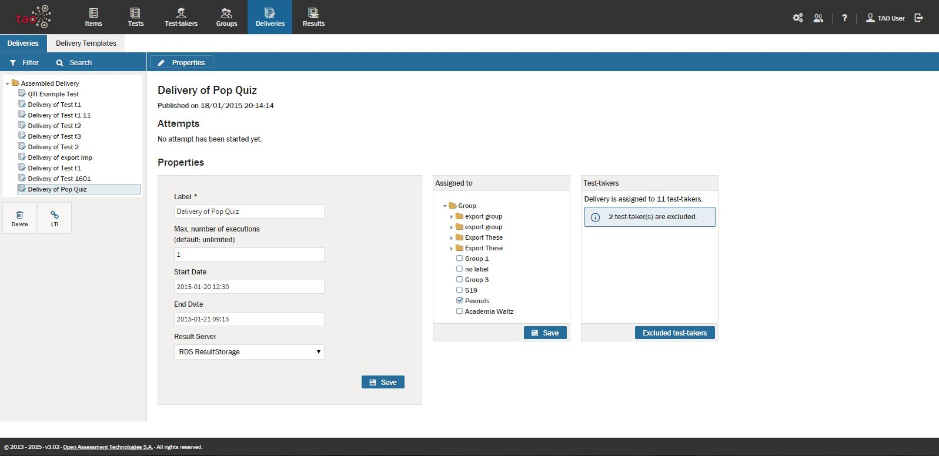
Assessment Builder Bar
Library
Action Bar
The name of the Test to be taken is given in the delivery title.
Canvas
Maximum number of times the Test-taker can take the Test.
Both save buttons need to be clicked.
Test-taker Groups are defined here.
The dates and times during which the Test-taker can work on and submit the Test.
Specific Test-takers in a Group can be excluded, if desired
Location where Results are saved to.

Slide 2
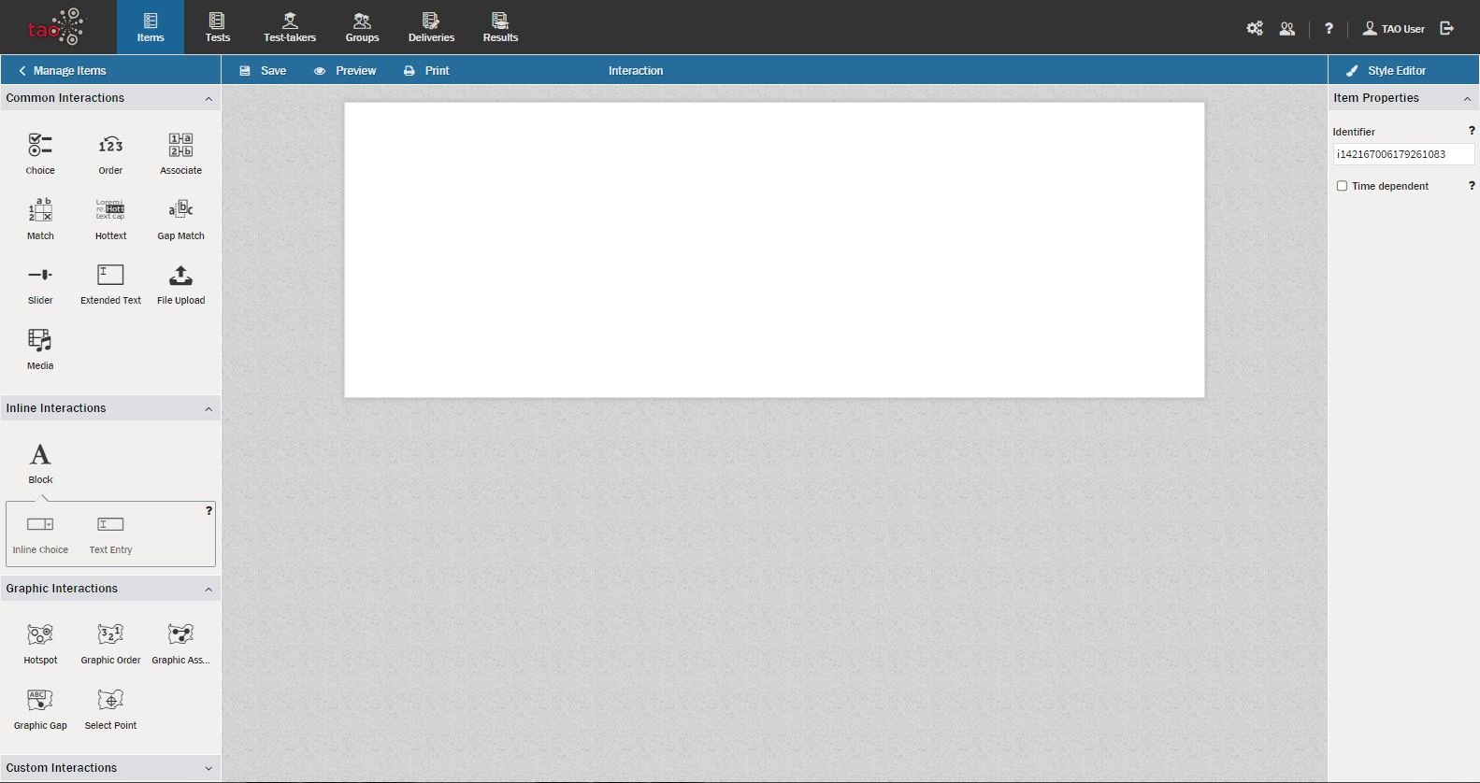
Assessment Builder Bar
Library
Action Bar
Canvas
Properties Panel
Common Interactions present many of the simple interactions that are commonly used in testing.
Inline Interactions present many of the text-based interactions that are commonly used in testing.
Graphic Interactions present common graphical interactions that are used in testing.
Custom Interactions provide library space for miscellaneous interactions developed by the user.

Slide 3
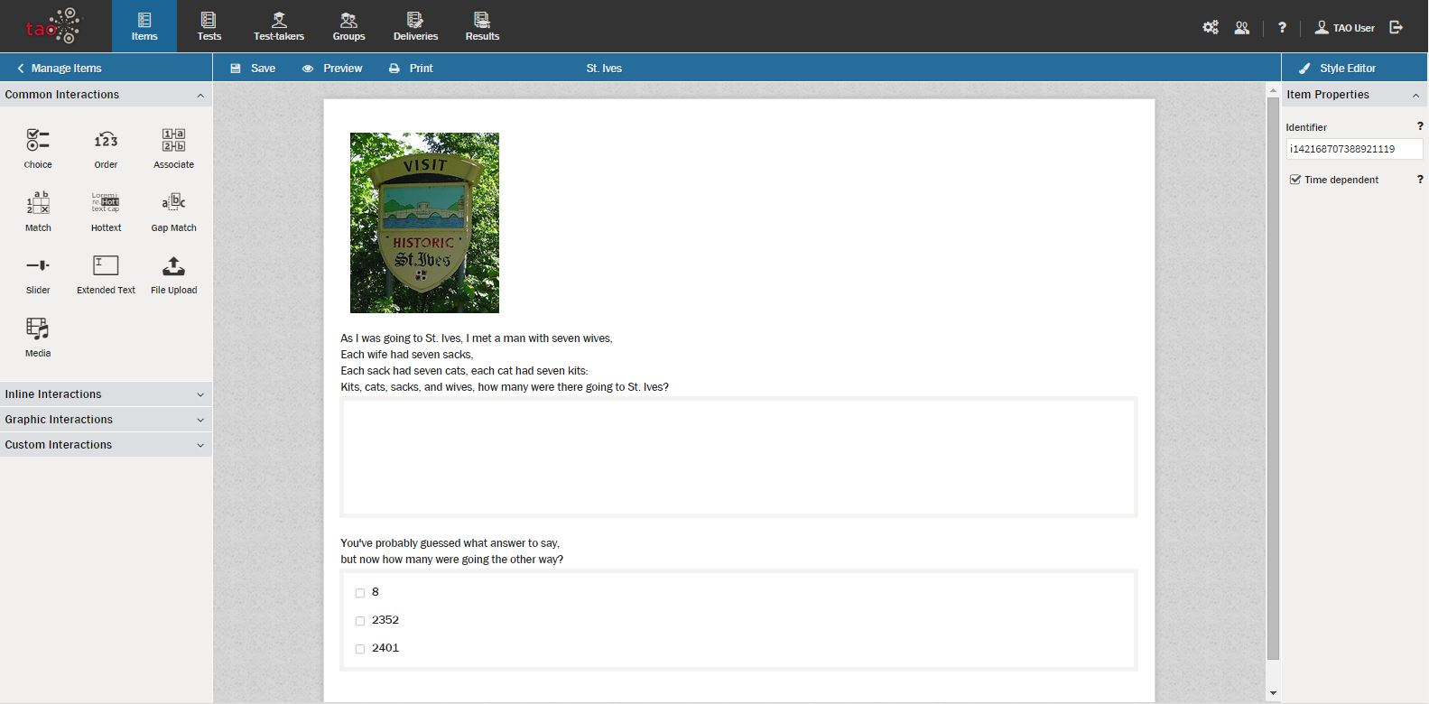
Assessment Builder Bar
Library
Action Bar
Canvas containing one Item (consisting of up to three interactions)
Simple still photograph, but could just as easily been a video (Media interaction).
Item Properties Panel
Extended text interaction (allows conveyance of the very short answer of “1”).
Time dependence is a property that limits the amount of time that the Test-taker has to answer the question.
This singular Item, used to gauge a student’s awareness of this ancient nursery rhyme and to quickly check math skills, actually contains two interactions (and could have contained a third if an appropriate St. Ives video were available for use).
Choice interaction (multiple choice question, with “2401” being the correct answer)

Slide 4
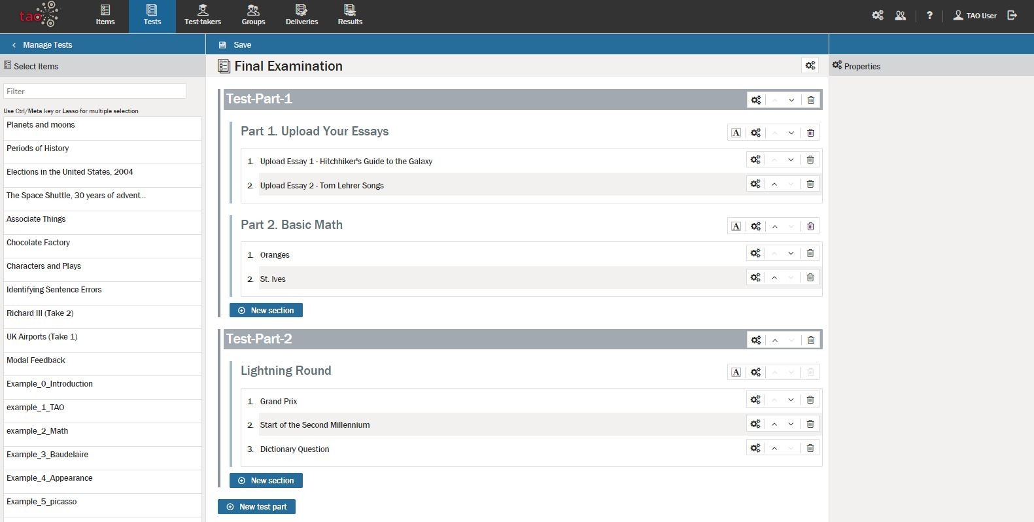
Assessment Builder Bar
Action Bar
Test Header with appropriate title
Library
Test Part
Test Segment
Properties Panel
Item (each contains interactions)
Canvas area containing Test

